Slide 1
Keras – ANN Implementation
UIUC ECON 490: Applied Machine Learning in Economics

Slide 2
Neural Network Architecture
Common structural choices

Slide 3
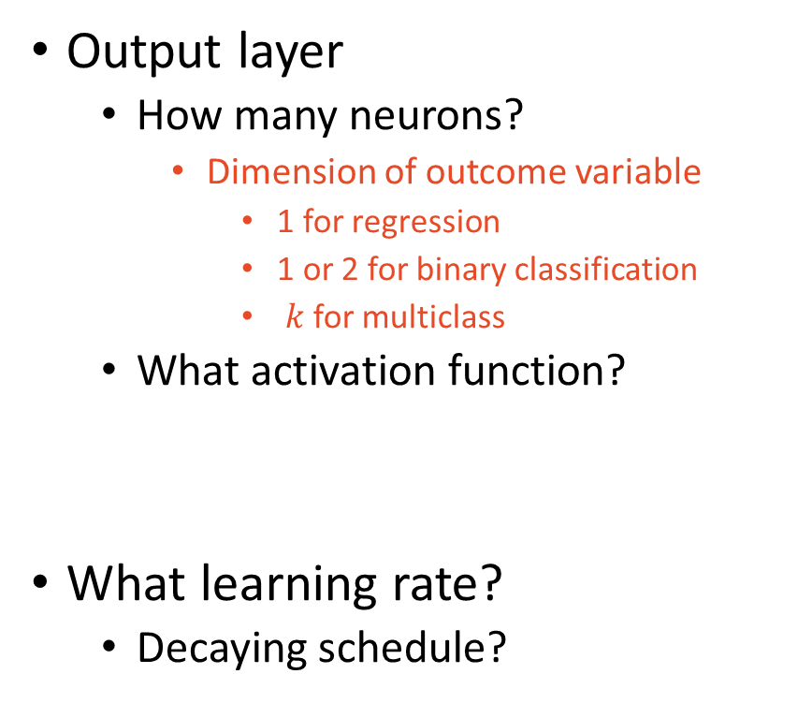
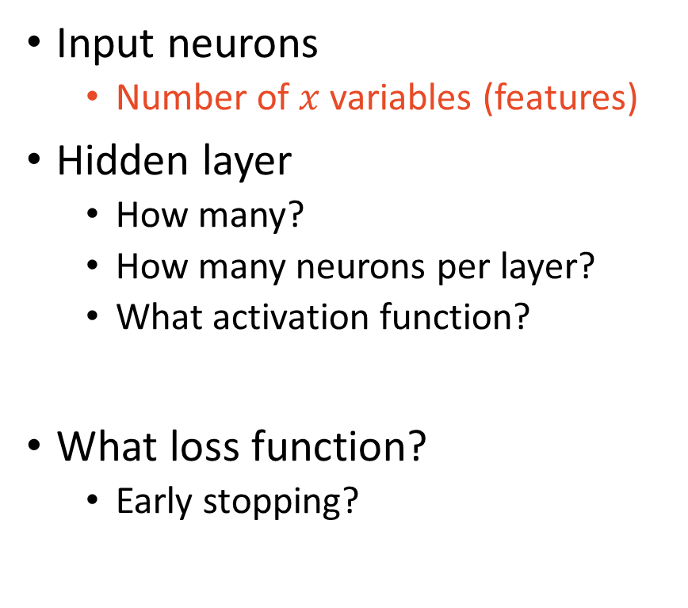
The Many Hyperparameters
Input neurons
Number of $x$ variables (features)
Hidden layer
How many?
How many neurons per layer?
What activation function?
What loss function?
Early stopping?
Output layer
How many neurons?
Dimension of outcome variable
1 for regression
1 or 2 for binary classification
$k$ for multiclass
What activation function?
What learning rate?
Decaying schedule?

Slide 4
Neurons & Layer Counts
Neurons
Input – 1 per variable
Hidden – 10 to 100
Note: if final hidden layer has 2 neurons but need to predict 3 classes
Output – 1 per dimension you want to predict
Layers
1 to 5 hidden layers
Recall linear activation function in hidden layers

Slide 5
NN for Regression vs. Classification
Output layer activation function in matters!
Bounds of activation determine possible predicted values
Hidden layers
More layers picks up on more subtleties
But distorts simple patters
Activation function – ReLU tends to work well in both problems
The deep learning definition

Slide 6
Output Activation Functions
Regression
Positive
ReLU
Softplus
Positive or Negative
None (linear)
Bounded
Sigmoid [0, 1]
Tanh [-1, 1]
Classification
Binary
Sigmoid
Multiclass
Softmax
Multiple Binary Labels
Sigmoid

Slide 7
The Keras Neural Network Process
Initialize
What kind of layers – “architecture”
Which hidden activation functions
Which output activation functions
Compile
Which loss and metric
Which optimizer
Learning rate schedule
Regularization
Fit
Batch size
Early stopping
Validation split
Epoch
Evaluate
Predict

Slide 8
Loss Functions
Regression
MSE
MAE if outliers
Classification
Cross entropy
(see Wikipedia for more info)

Slide 9
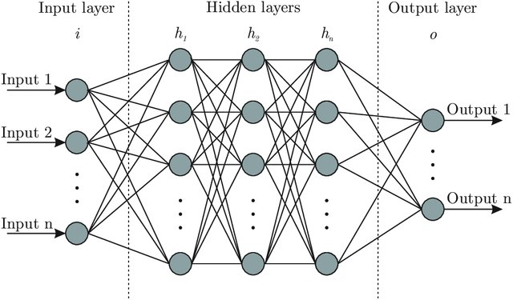
Feed-forward NN

Slide 10
Sequential NN

Slide 11

Questions?

